Slide 1
Suppressing Laser Triangulation’s Optical Aberrations by Replacing the Lens with a Slit
Benjamin Lapointe-Pinel
Steven Pigeon
Université du Québec à Rimouski

Slide 2
Introduction
Need for a way to measure distances without contact
Centimeter-scale distances ⮕ laser triangulation sensors
Accuracy in the order of micrometers

Slide 3
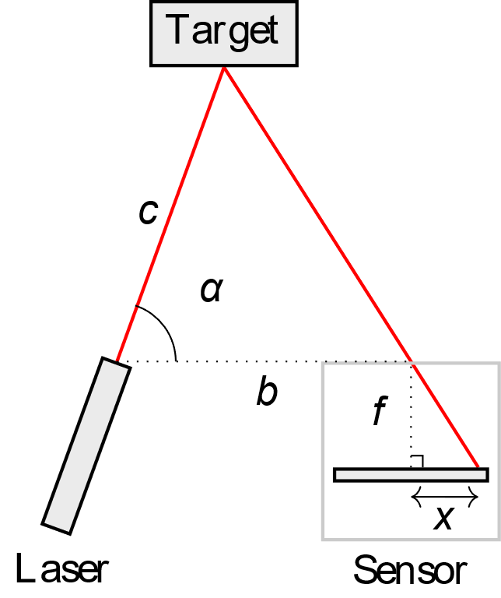
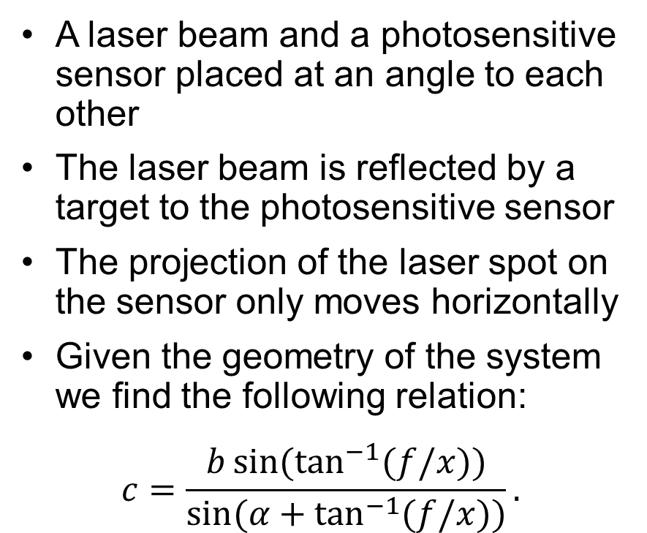
Laser Triangulation Geometry
A laser beam and a photosensitive sensor placed at an angle to each other
The laser beam is reflected by a target to the photosensitive sensor
The projection of the laser spot on the sensor only moves horizontally
Given the geometry of the system we find the following relation:
$$c=\frac{b\sin{(\tan^{−1}{(f/x)})}}{\sin{(α+\tan^{−1}{(f/x)})}}.$$

Slide 4
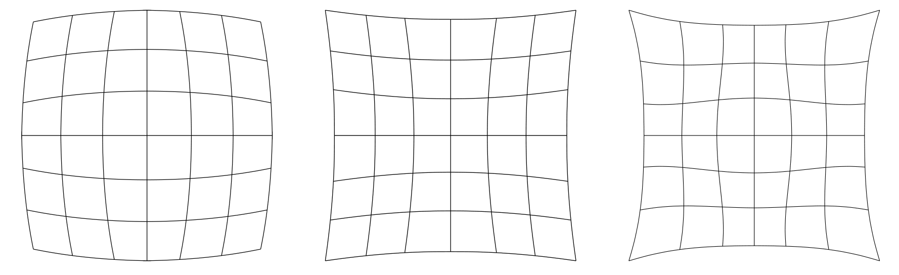

Lens Monochromatic Optical Aberrations
Defocus
Spherical
Coma
Astigmatism
Field curvature
Image distortion
Also susceptible to lens flare

Slide 5
Pinhole Photography advantages
Offers a theoretically infinite depth of field
Does not create spherical optical aberration
Does not create coma
Does not create field curvature
Does not create distortion
Decreases lens flare
Easily offers a viewing angle of up to 180°

Slide 6
Pinhole Photography disadvantages
Longer exposure time
Symmetrical astigmatism on the horizontal axis
Chromatic aberrations (can be neglected for this use case)

Slide 7
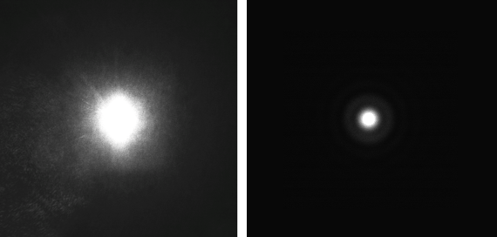
Circular Aperture Diffraction Pattern
A laser observed through a pinhole creates an Airy disk diffraction pattern
It is sharper and symmetrical
Lens laser spot on sensor
Airy disk on sensor

Slide 8
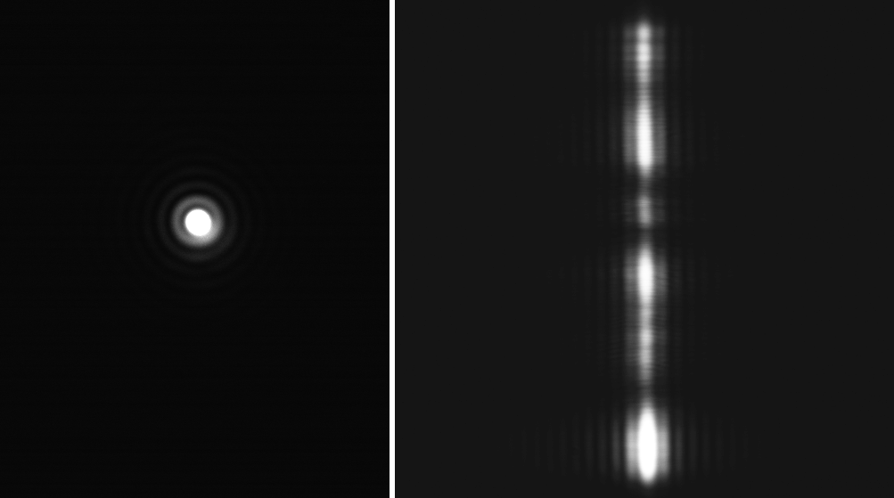
Slit Diffraction Pattern
Diffraction is sensitive to speckle noise
Replace circular aperture with vertical slit
line-by-line analysis, averaging the errors in each pixel lines
Airy disk deformed by
speckle noise
Slit diffraction pattern

Slide 9
Hypothesis
Replacing the lens with a slit:
Improves accuracy and range by bypassing most of the optical aberrations of lenses
Decreases internal reflection
Offers better range
Exploits diffraction patterns for better image analysis

Slide 10
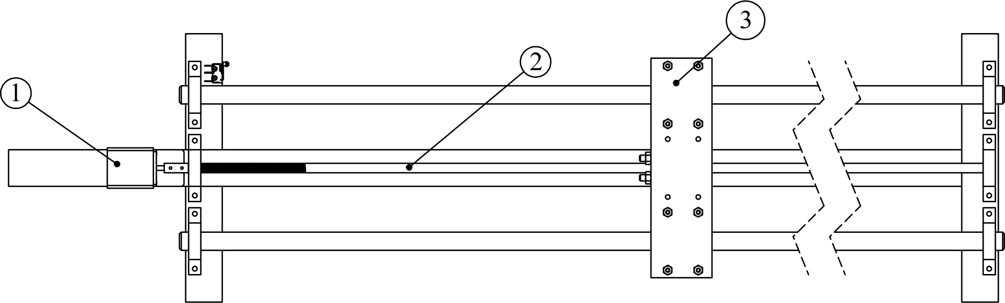
Prototype
Carriage that can support different targets, placed on a worm screw
Capture at 25 μm intervals, 60 cm to 102 cm from to sensor
Capture done on different materials
Brushed metal
Unevenly rusted metal
Light wood plank
Printer paper
Black electrical tape
Microfiber cloth
Motorized linear displacement table
Notes:
42 cm is the useful range of the lens, the slit has a larger one

Slide 11
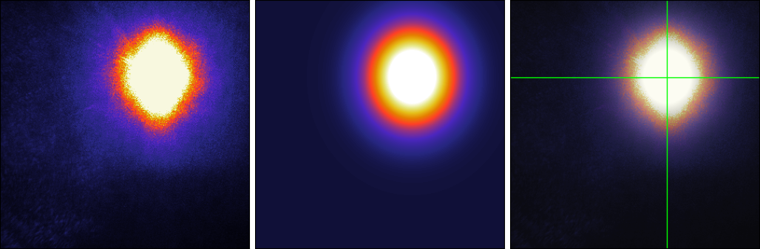
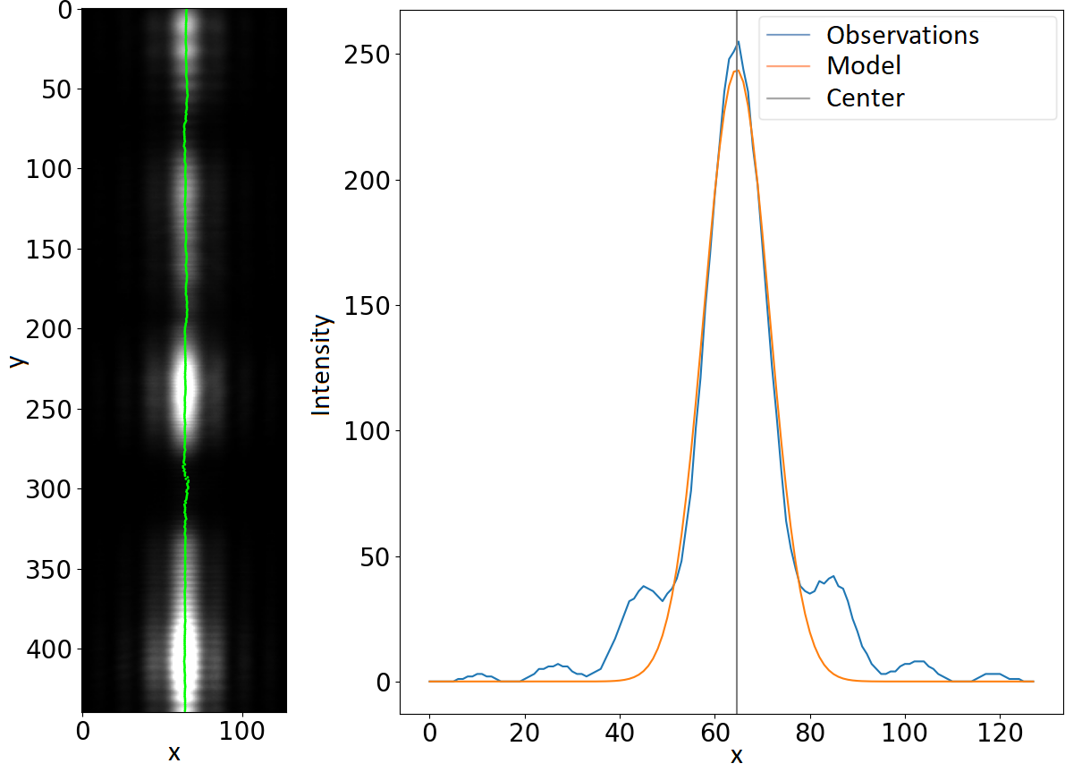
Algorithms
Least squares regression of Gaussian Function
Lens: 2D
Slit: line-by-line

Slide 12
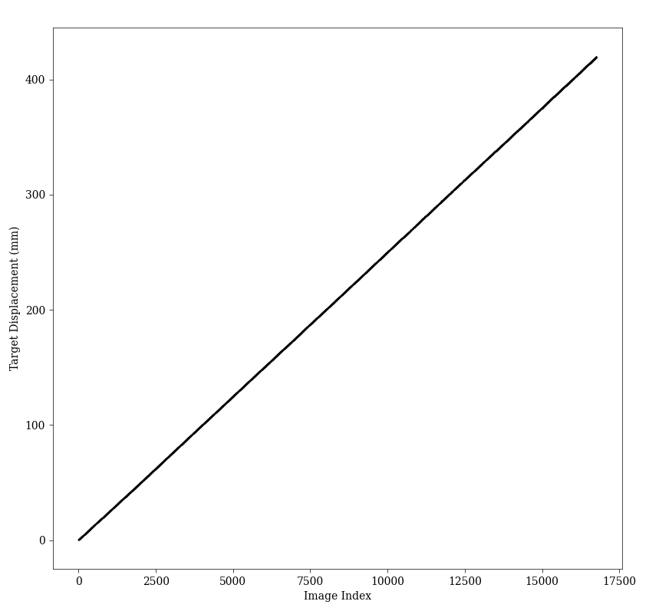
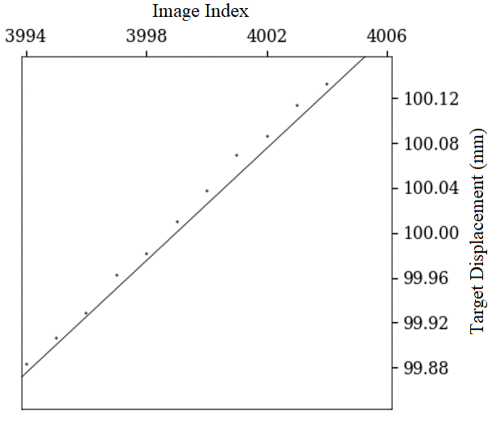
Distance Model Predictions

Slide 13
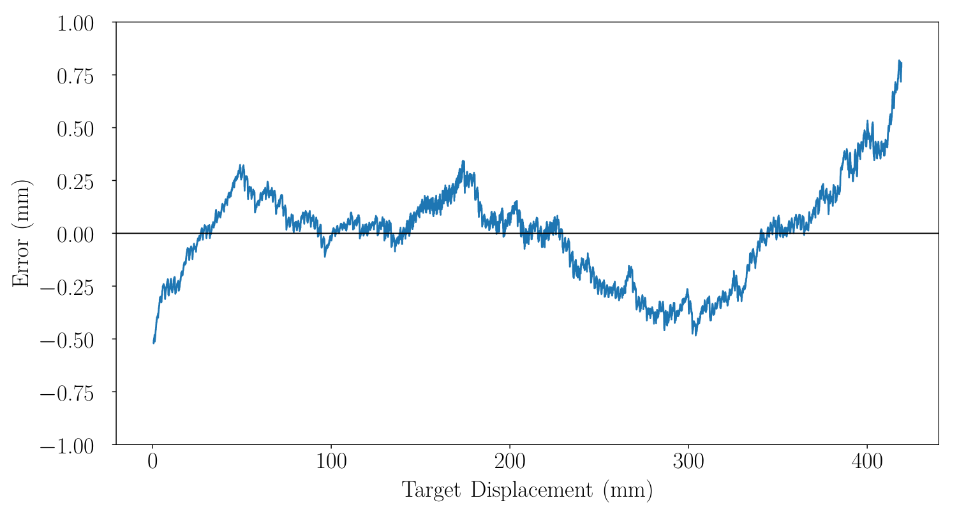
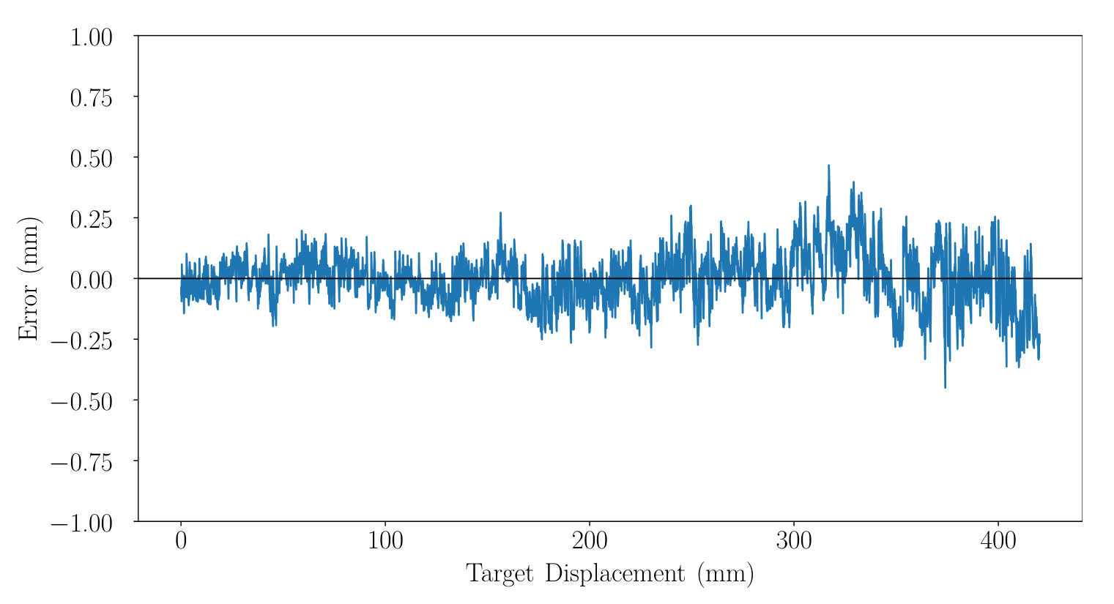
Model Prediction Errors Examples
Lens
Slit
Notes:
The slit range goes on for more

Slide 14
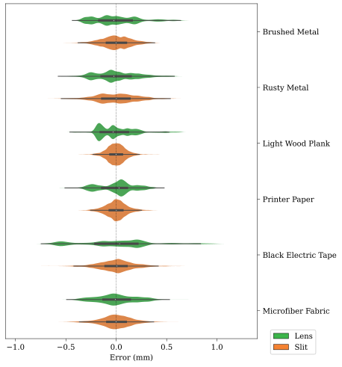
Violin Plot of Errors

Slide 15
Conclusion
Hypothesis verified:
Slit bypassing most of the optical aberrations of lenses
Slit decreases internal reflection
Slit offers better range
Slit diffraction pattern symmetry helps with image analysis
Slit is less precise, but overall, more accurate in average
Image darkened and affected by speckle noise

Slide 16
Potential Improvements
Shorter wavelength laser
Other speckle noise mitigations
Usage of the Fraunhofer or the Fresnel approximations

Slide 17
Acknowledgements
Suzie Loubert, mechanical engineer at UQAR, for her drawings of the experimentation table
Richard Lafrance, mechanical technician at UQAR, for the assembly of the table
Jean-Charles Morin, electrical technician at UQAR, for his help in repairing the circuit of the table's motor.

Slide 18
References
F. Blais, “Review of 20 years of range sensor development,” Journal of Electronic Imaging, vol. 13, no. 1, p. 231, Jan. 2004
S. Gokturk, H. Yalcin, and C. Bamji, “A time-of-flight depth sensor—system description, issues and solutions,” in 2004 Conference on Computer Vision and Pattern Recognition Workshop. IEEE, 204, p. 35
S. V. F Barreto, R. E. Sant’Anna, and M. A. F. Feitosa, “A method for image processing and distance measuring based on laser distance triangulation,” in IEEE 20th International Conference on Electronics, Circuits, and Systems (ICECS), 2013, pp. 695-698
T. A. Clarke, K. V. T. Grattan, and N. E. Lindsey, “Laser-based triangulation techniques in optical inspection of industrial structures,” in Optical Testing and Metrology III: Recent Advances in Industrial Optical Inspection, C. P. Grover, Ed., vol. 1332. SPIE, Jan 1991, pp. 474-486
A. Donges and R. Noll, Laser Measurement Technology. Springer Berlin Heidelberg, 2015
Z. Ji and M. Leu, “Design of optical triangulation devices,” Optics & Laser Technology, vol. 21, no. 5, pp. 339-341, 1989
S. Kumar, P. K. Tiwari, and S. Chaudhury, “An optical triangulation method for non-contact profile measurement,” in 2006 IEEE International Conference on Industrial Technology. IEEE, 2006, pp.2878-2883
N. Swojak, M. Wieczorowski, and M. Jakubowicz, “Assessment of selected metrological properties of laser triangulation sensors,” Measurement, vol. 176, May 2021
T. Bosch, “Laser ranging: a critical review of the usual techniques for distance measurement,” Optical Engineering, vol. 40, no. 1, pp. 10-19, Jan. 2001
M. Young, “Pinhole optics,” Applied Optics, vol. 10, no. 12, pp. 2763-2767, December 1971
M. Young, “Pinhole imagery,” American Journal of Physics, vol. 40, no. 5, pp. 715-720, May 1972
J. M. Franke, “Field-widened pinhole camera,” Applied Optics, vol. 18, no. 17, p. 2913, Sep. 1979
T. Hsu, “Reflective wide-angle pinhole camera,” Applied Optics, vol. 21, no.13, p. 2303, Jul. 1982
R. Baribeau and M. Rioux, “Influence of speckle on laser range finders,” Applied Optics, vol. 30, no. 26, pp. 2873-2878, Jul. 1991
R. Baribeau and M. Rioux, “Centroid fluctuations of speckled targets,” Applied Optics, vol. 30, no. 26, pp. 3752-3755, Sep. 1991
R. G. Dorsch, G. Häusler, and J.M. Herrmann, “Laser triangulation: fundamental uncertainty in distance measurement,” Applied Optics, vol. 33, no. 7, pp. 1306-1314, Mar. 1994
M. Born, E. Wolf, A. B. Bhatia, P. C. Clemmow, D. Gabor, A. R. Stokes, A. M. Taylor, P. A. Wayman, and W. L. Wilcock, Principles of Optics. Cambridge University Press, Oct. 1999

Slide 19
Thank you for your attention
Benjamin.Lapointe-Pinel@uqar.ca
Steven_Pigeon@uqar.ca

